Slide 1

8th Grade Math: Pre-Algebra
Unit 7, Lesson 6 Interpreting Linear Relationships from Graphs and Equations Volume 1, pg. 310

Slide 2


Benchmark
MA.8.AR.3.5
Given a real-world context, determine and interpret the slope and 𝑦-intercept of a two-variable linear equation from a written description, a table, a graph, or an equation in slope-intercept form.
volume 1, pg. 310

Slide 3
Integrated Mathematical Thinking and Reasoning Standards
MA.K12.MTR.6.1 Assess the reasonableness of solutions.
MA.K12.MTR.7.1 Apply mathematics to real-world contexts.
volume 1, pg. 310

Slide 4

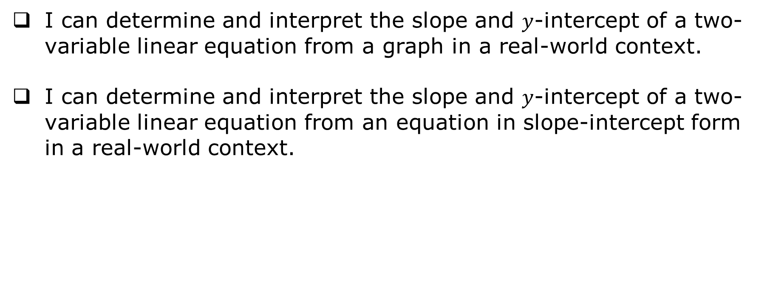
Learning Targets
I can determine and interpret the slope and $y$-intercept of a two-variable linear equation from a graph in a real‑world context.
I can determine and interpret the slope and $y$-intercept of a two-variable linear equation from an equation in slope-intercept form in a real-world context.
volume 1, pg. 310

Slide 5

Warm-Up
volume 1, pg. 311

Slide 6

7.6.1 Warm-Up: Success vs. Failure
John Legend shares that even though he is seen as a successful musician, he actually tried to get a record deal for six years without any success. He explains that most successful people go through a lot of missteps before reaching their goal.
He said, “The great ones aren’t the ones who don’t fail, they’re the ones who learn from their failure, and they keep going.”
volume 1, pg. 311

Slide 7
John Legend explains that innate talent is not always enough. He only went to the next level in his career after hiring a voice coach and studying to get better.
Think of something in your life you are successful with.
What have you done to grow and improve this talent?
volume 1, pg. 311

Slide 8

Guided Instruction
volume 1, pg. 311

Slide 9
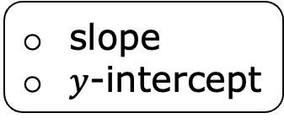
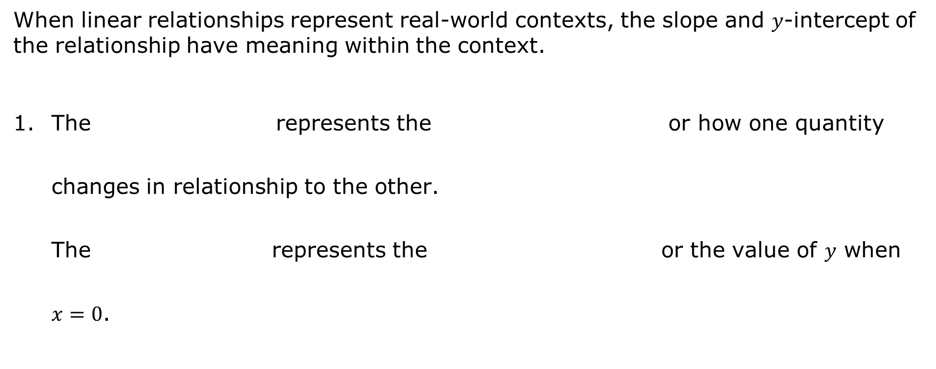
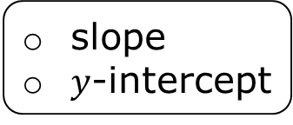

7.6.2 Guided Instruction: Interpreting Slope and $y$-intercept from Equations and Graphs
When linear relationships represent real-world contexts, the slope and $y$-intercept of the relationship have meaning within the context.
The represents the or how one quantity changes in relationship to the other. The represents the or the value of $y$ when $x=0$.
slope
$y$-intercept
initial value,
rate of change,
slope
$y$-intercept
initial value,
rate of change,
volume 1, pg. 311

Slide 10
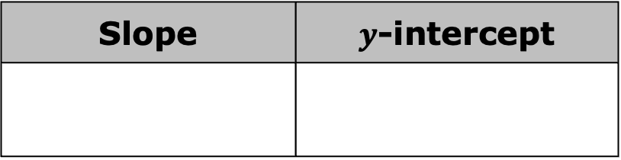
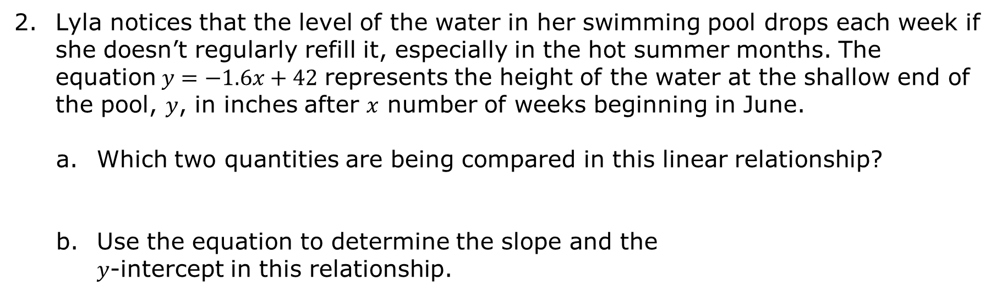
Lyla notices that the level of the water in her swimming pool drops each week if she doesn’t regularly refill it, especially in the hot summer months. The equation$y=−1.6x+42$ represents the height of the water at the shallow end of the pool, $y$, in inches after $x$ number of weeks beginning in June.
Which two quantities are being compared in this linear relationship?
Use the equation to determine the slope and the $y$-intercept in this relationship.
Slope | $y$-intercept
volume 1, pg. 312

Slide 11
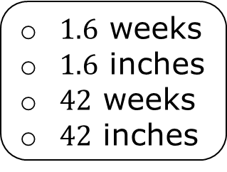
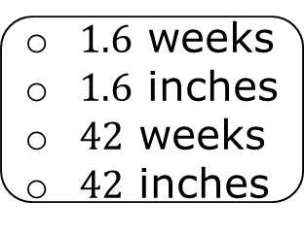

Complete each statement to interpret the meaning of each value in context. The slope means is by each beginning in June.
The $y$-intercept means is on ____________.
the height of the water in the pool
the number of weeks since June 1st
increasing
decreasing
$1.6$ weeks
$1.6$ inches
$42$ weeks
$42$ inches
inch
week
the height of the water in the pool
the number of weeks since June 1st
$1.6$ weeks
$1.6$ inches
$42$ weeks
$42$ inches
volume 1, pg. 312

Slide 12
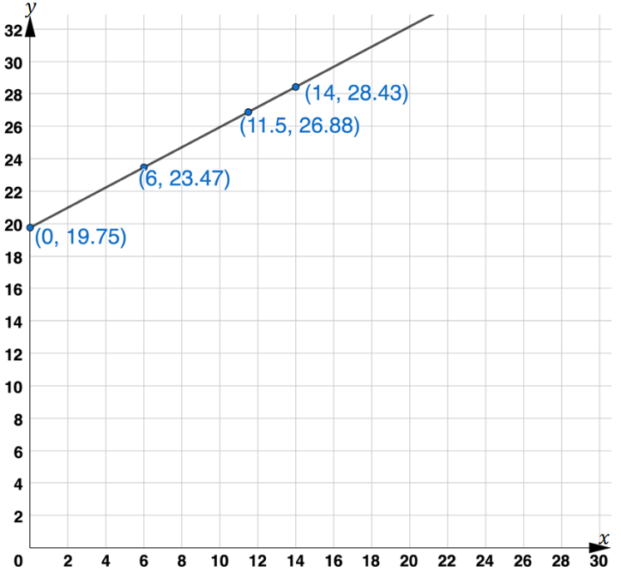
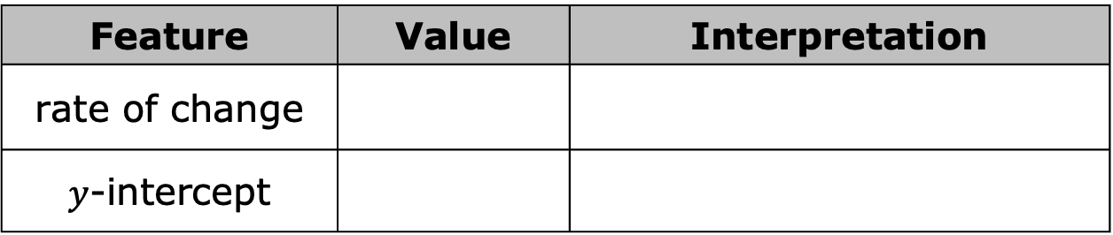
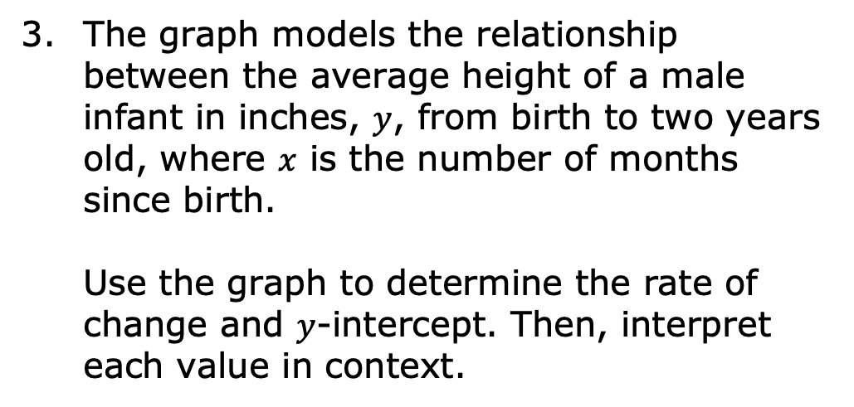
The graph models the relationship between the average height of a male infant in inches, $y$, from birth to two years old, where $x$ is the number of months since birth. Use the graph to determine the rate of change and $y$-intercept. Then, interpret each value in context.
Feature | Value | Interpretation
rate of change
$y$-intercept
volume 1, pg. 312

Slide 13

Collaboration
volume 1, pg. 313

Slide 14

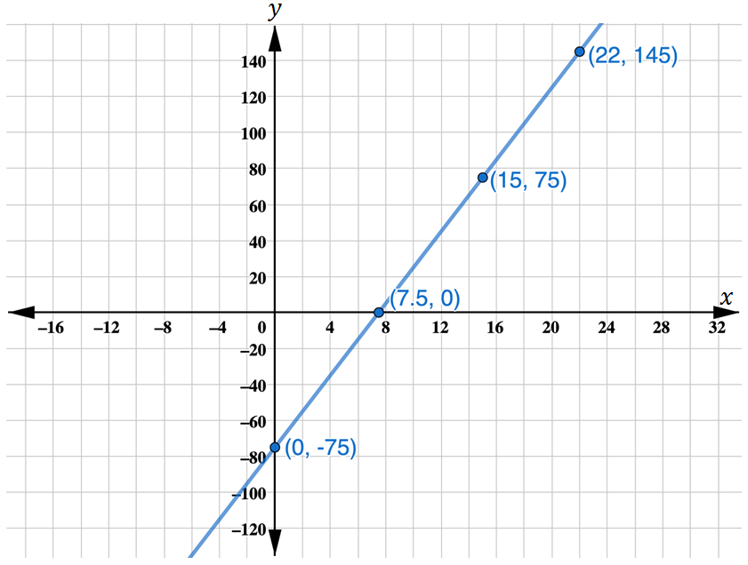
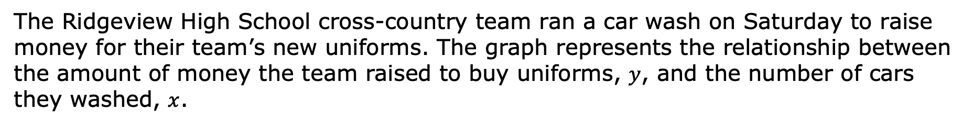
7.6.3 Collaboration: Making Sense of Mathematical Models
The Ridgeview High School cross-country team ran a car wash on Saturday to raise money for their team’s new uniforms. The graph represents the relationship between the amount of money the team raised to buy uniforms, $y$, and the number of cars they washed, $x$.
volume 1, pg. 313

Slide 15
Work with your partner to answer the questions using the information given in the graph.
What is the slope of the line? Show your work.
What does the slope mean in this context?
Explain whether the meaning of the slope makes sense in this context.
volume 1, pg. 313

Slide 16
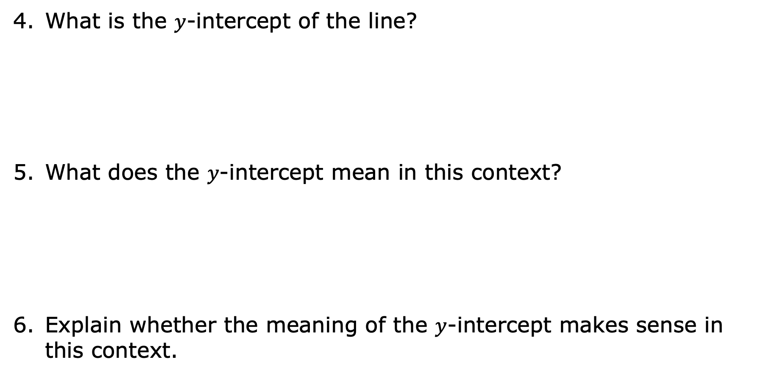
What is the $y$-intercept of the line?
What does the $y$-intercept mean in this context?
Explain whether the meaning of the $y$-intercept makes sense in this context.
volume 1, pg. 313

Slide 17
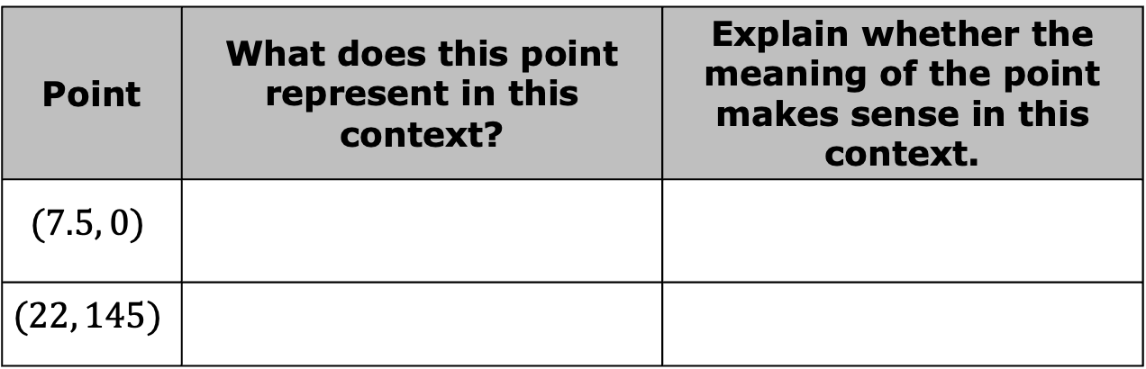
Complete the table.
What parts of the graph do not make sense in this context?
Discuss with your partner whether the graph is useful for modeling this situation, even if there are parts of it that do not make sense given the context.
Point | What does this point represent in this context? | Explain whether the meaning of the point makes sense in this context.
$$(7.5, 0)$$
$$(22, 145)$$
volume 1, pg. 314

Slide 18

Bring It Together
volume 1, pg. 314

Slide 19

7.6.4 Bring It Together: Making Sense of Mathematical Models
Mathematical modeling is a process that uses mathematics to represent, analyze, and make predictions about real-world phenomena.
Today’s lesson explores two mathematical models – _______________ and _______________.
Mathematical models are helpful tools to use to understand a situation and make predictions. However, sometimes the mathematical model can include parts that do not make sense in a real-world context.
volume 1, pg. 314

Slide 20
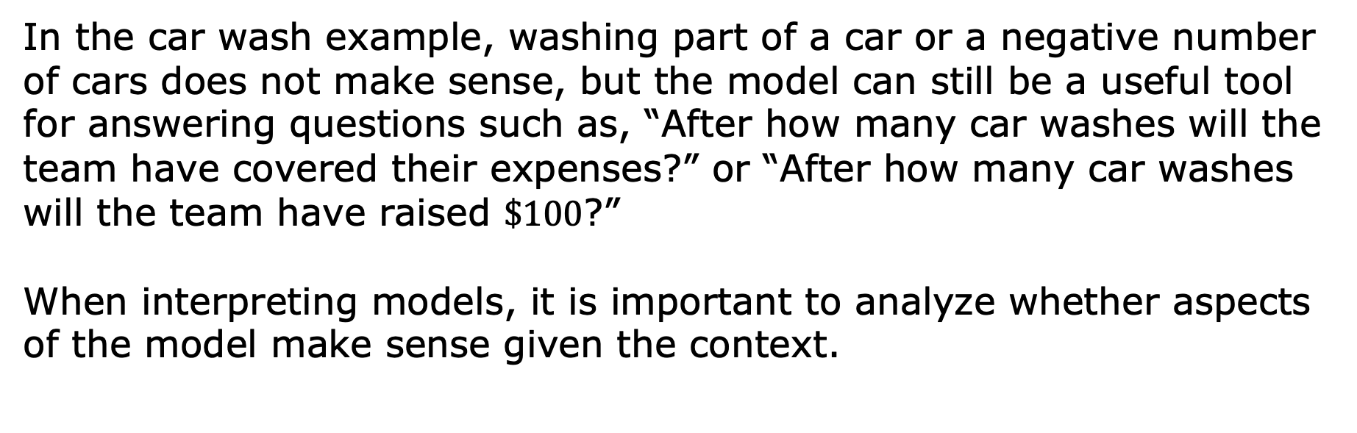
In the car wash example, washing part of a car or a negative number of cars does not make sense, but the model can still be a useful tool for answering questions such as, “After how many car washes will the team have covered their expenses?” or “After how many car washes will the team have raised $\$100$?”
When interpreting models, it is important to analyze whether aspects of the model make sense given the context.
volume 1, pg. 314

Slide 21

Guided Practice
volume 1, pg. 315

Slide 22

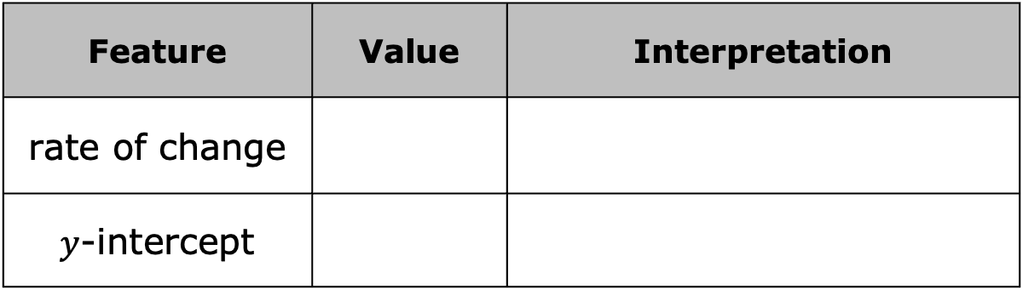
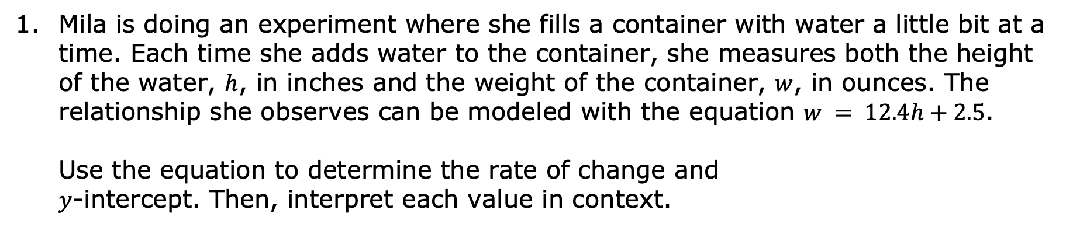

7.6.5 Guided Practice: Interpreting Slope and $y$-intercept in Real-World Contexts
Mila is doing an experiment where she fills a container with water a little bit at a time. Each time she adds water to the container, she measures both the height of the water, $h$, in inches and the weight of the container, $w$, in ounces. The relationship she observes can be modeled with the equation $w = 12.4h+2.5$. Use the equation to determine the rate of change and $y$-intercept. Then, interpret each value in context.
Feature | Value | Interpretation
rate of change
$y$-intercept
volume 1, pg. 315

Slide 23

Your Turn
volume 1, pg. 315

Slide 24
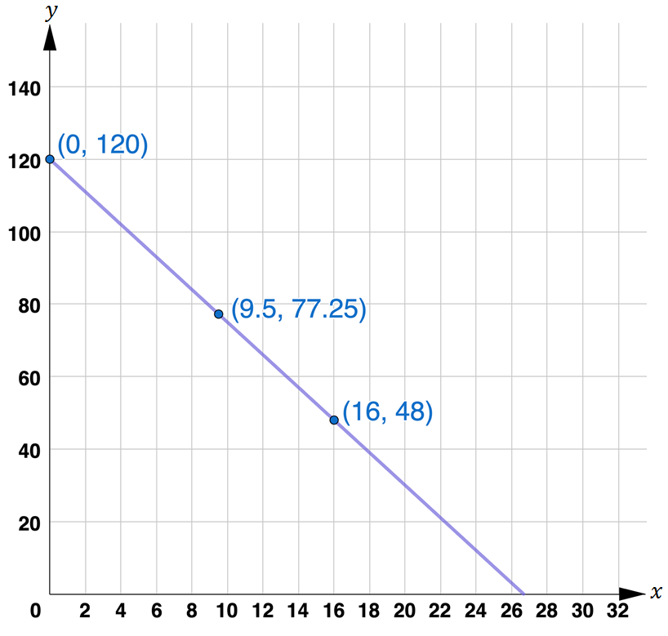
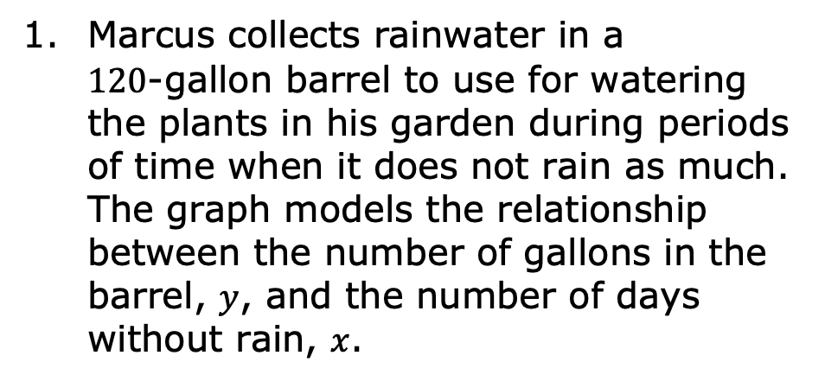
7.6.6 Your Turn!
Marcus collects rainwater in a $120$-gallon barrel to use for watering the plants in his garden during periods of time when it does not rain as much. The graph models the relationship between the number of gallons in the barrel, $y$, and the number of days without rain, $x$.
volume 1, pg. 315

Slide 25
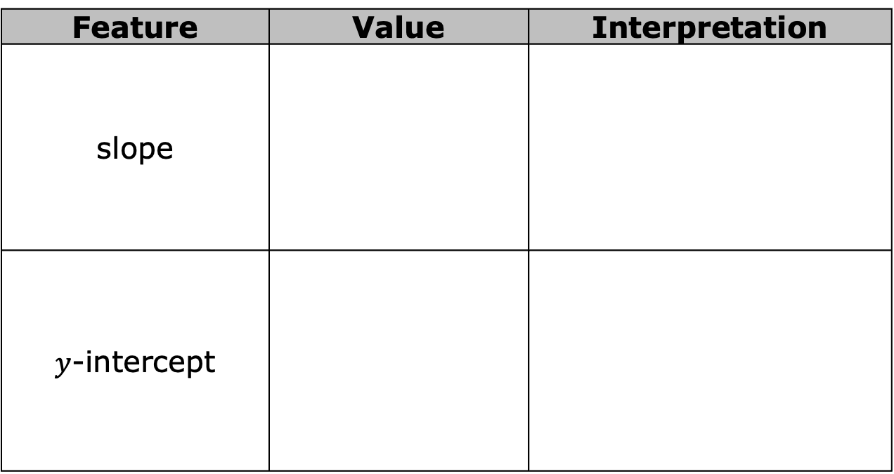
Use the graph to determine the slope and $y$-intercept. Then interpret each value in context.
Feature | Value | Interpretation
slope
$y$-intercept
volume 1, pg. 315

Slide 26

Wrap-Up
volume 1, pg. 316

Slide 27
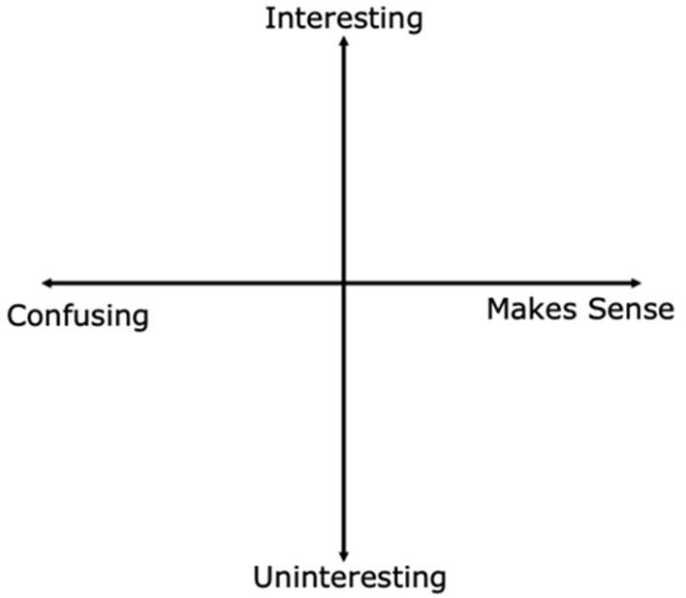
7.6.7 Wrap-Up: Reflection
Plot a point on the grid to indicate your level of interest and understanding for today’s learning targets.
Explain why you placed the point where you did.
volume 1, pg. 316

